Slide 1
Sarcasm Detection 🤔
Connie Chen, Mickey Shi, Nathaniel Imel, Sadaf Khan

Slide 2
Task Description: Intro
Sarcasm is a form of irony used to mock or show contempt
Verbal sarcasm vs. written sarcasm
Facial features and prosodic changes vs. punctuation and emojis
Why is sarcasm detection useful?
Discrepancy between literal vs. intended meaning
Sentiment analysis and harassment detection
Notes:
Introduce sarcasm
Identify differences between verbal and written sarcasm so audience knows different challenges identification of each one poses. - Verbal sarcasm can be identified by cues such as facial feature and prosodic changes. - Written sarcasm can be identified by cues such as punctuation and emojis
What is sarcasm detection used for? - Sarcasm in data can negatively impact classification accuracy when not accounted for (i.e. when taken literally instead of sarcastically) - Some tasks sarcasm detection is used in include sentiment analysis and harassment detection

Slide 3
Task Description: Primary Task & Data
Determine whether a given English tweet is sarcastic or not.
Data is from iSarcasmEval shared-task.
Each text is labelled by the author of the text themselves.
Sarcastic=1; non-sarcastic=0
Tweet | Label
The only thing I got from college is a caffeine addiction | 1
All these exams😭 | 0
Notes:
Primary Task
Data
Number of unique authors is unknown

Slide 4
Task Description: Data
 | # of Sarcastic | # of Non-sarcastic | Total
Train | 780 | 2342 | 3122
Dev | 86 | 260 | 346
Test | 200 | 1200 | 1400
Notes:
Given train and test data from the sarcasmeval task, we use 10% of train as dev
Train:
3468 English tweets
867 sarcastic
2,601 non-sarcastic
Dev (10% of original train set):
Test:
1400 english tweets
200 sarcastic
1200 non-sarc
Notice how our data set is quite small and imbalance where there are a lot more non sarcastic tweets in comparison to sarcastic ones. We will further discuss issues possibly presents to our task in a later slide.

Slide 5
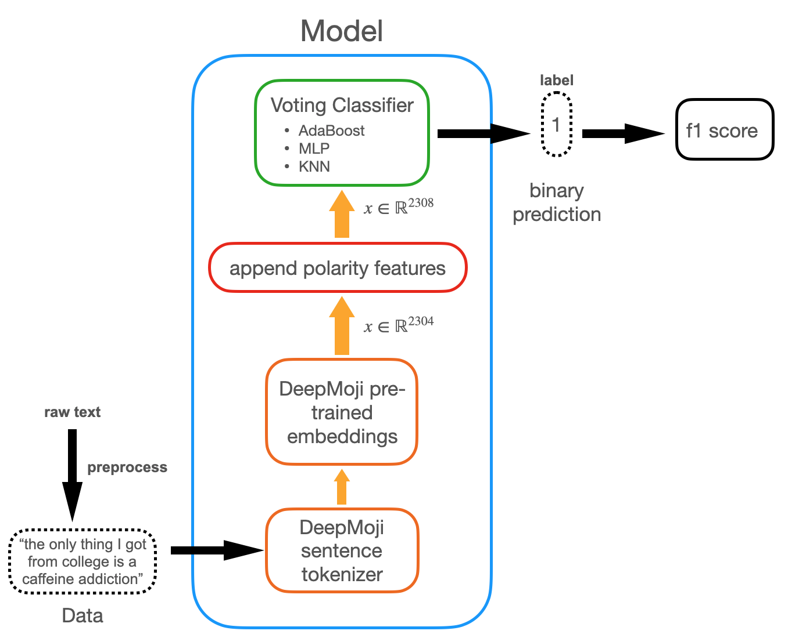
Notes:
I don’t know if we need the lil blurb on the left. It’s just text version of the figure but if it is helpful for speaking then leave it lol
Maybe add a figure of the vectorization process!

Slide 6
Polarity
A large absolute difference in positivity could be a pragmatic marker for sarcasm [Rajadesingan et. al. 2015]
VaderSentiment generated positive/negative scores per tweet
Scores appended to the DeepMoji vector
Note: VaderSentiment’s positivity evaluation on keywords in our dataset suggests it doesn’t actually catch many words (mostly nouns) that are connoted negatively:
Negative words that analyzed as neutral: "unwell", "lockdown", "covid", "taxes", "politicians", “gaslight”
Positive words analyzed as neutral: “lmaoo”, “convenient”

Slide 7
Classifiers
Deliverable 2
SVM, with linear, sigmoid, rbf kernels
Random Forest with differing depths
Deliverable 3
K-neighbors
AdaBoost
MLP neural network
Voting ensembles of various configurations of classifiers above

Slide 8
Results (Macro F1 Scores)
 | Predict Random | MLP Neural NET | MLP Neural Net + Polarity | Adaboost | Adaboost + Polarity | kNN | kNN + Polarity | Voting Ensemble | Voting Ensemble + Polarity
Train | 0.4754 | 0.9978 | 0.9978 | 0.6934 | 0.6934 | 0.6846 | 0.6870 | 0.8149 | 0.8187
Dev | 0.4820 | 0.9610 | 0.9376 | 0.6657 | 0.6657 | 0.6365 | 0.6495 | 0.7660 | 0.7906
Test | 0.4190 | 0.6008 | 0.5776 | 0.6160 | 0.6160 | 0.6194 | 0.6375 | 0.6421 | 0.6531
Notes:
Selected the top 6 models of the 20 ran
Baseline in black of 0.4190;Highest F1 of Voting Ensemble + Polarity, 0.6531
Ensemble consisted of kNN, AdaBoost (DT classifiers), MLP NN; decided to create Voting based off the top performing models of the other classifiers
Hence those models are the next best performing
Classifiers run on polarity enriched vectors in red
Polarity info helped with some models: kNN, Voting
Disadvantaged other models: MLP NN
Made no difference for AdaBoost
NN trained really well for Train and Dev, but did badly on Test?

Slide 9
D2 vs. D3
In D2, linear SVM performed the best (F1 = 0.54)
In D3, we
Pre-processed data
Added polarity information
Tried additional classifiers
Resulted in
Overall increase in F1s
Classifier-specific F1 increase with polarity information
Best-performing model being ensemble Voting of highest-performing models (F1 = 0.65)
Notes:
Removed usernames and links that aren’t semantically meaningful
Used VaderSentiment for polarity enriching
Added classifiers like MLP NN, kNN, AdaBoost, Logistic Regression, NB, etc.
All the F1s increased

Slide 10
Successes
Implemented functioning affect recognition system
Successive iterations of classifiers
Implemented sentiment feature engineering

Slide 11
Issues: Is this sarcastic?
Sarcasm is difficult to identify devoid of context, even for human observers, and many examples in the dataset lack critical context
If a human observer has difficulty, a classifier on this data will be either inaccurate or overfitted
Sarcastic | You look fantastic in that new dress. It shows off your figure
 | Weathers wonderful today! 🎉 🎉 🎉
 | hate it here ❤ ❤ ❤ ❤ ❤
 | Biden is a great President like none other we have had
 | buy really rare pokemon card
Not | Who says the NHS isn’t a wonderful thing?
 | "“You’re English right?” “Yeah, big time”"
 | Well it's clear further restrictions are coming as I've been able to book my booster for this week

Slide 12
Current classifier issues
Classifier has no notion of semantics, which is necessary for certain tweets that require niche knowledge
Our classifier misses on a number of tweets concerning British/American politics, Christmas, etc
VaderSentiment polarity metric doesn’t flag many pandemic-related terms as negative
General lean toward genuine, rather than sarcastic interpretations

Slide 13
Other issues with the dataset
Duplicate sarcasm examples in the test dataset
Differences in test/train composition: test dataset seems to have been trimmed of @mentions, whereas they’re plentiful in the training dataset
Many of the tweets concern Covid laws and curfews, which might not hold up well given new data
Different ratios of sarcastic vs. non-sarcastic data in test and training datasets
Non-English examples in the dataset

Slide 14
Future additions
Adaptation task: discriminate between a sarcastic and non-sarcastic rephrase.
More feature engineering
Additional error analysis

Slide 15
Related Reading
Aditya Joshi, Pushpak Bhattacharyya, and Mark J Carman. 2017. Automatic sarcasm detection: A survey.ACM Computing Surveys (CSUR), 50(5):1–22.
David Bamman and Noah Smith. 2015. Contextualized sarcasm detection on twitter. In Proceedings of the International AAAI Conference on Web and Social Media, volume 9, pages 574–577.
Ashwin Rajadesingan, Reza Zafarani, and Huan Liu. 2015. Sarcasm Detection on Twitter: A Behavioral Modeling Approach. In Proceedings of the Eighth ACM International Conference on Web Search and Data Mining (WSDM '15). Association for Computing Machinery, New York, NY, USA, 97–106.

